Slide 1

DSP Mini Project: Denoising Audio
Course: Digital Signal Processing
Course Code: 23EECC303
Semester: V
Credits: 4 [2-0-2]
Hours/Week: 6
Faculty Mentor: Mrs Nirmala Mam
Team Details
Sl.No. | Roll No. | Div | SRN | Name
1 | 459 | D | 01FE23BEC224 | Srikrishna Hireholi
2 | 413 | D | 01FE23BEC174 | Kartik Terdal
3 | 406 | D | 01FE23BEC166 | Mantesh Imangoudar
4 | 457 | D | 01FE23BEC222 | Swaroop Swami

Slide 2
Content
Title:
Introduction
This project applies basic Digital Signal Processing techniques to enhance an audio signal by transforming it to the frequency domain, removing noise, and reconstructing a cleaner signal using DFT and IDFT.
Overview of Digital Signal Processing in Image Enhancement
Although DSP is widely used in image enhancement, the same principles apply to 1-D audio. Frequency-domain analysis helps isolate noise components and improve signal quality.
Objective of the Project
To manually implement DFT and IDFT, analyze the audio frequency spectrum, remove high-frequency noise, and reconstruct the denoised time-domain signal.
Problem Statement
Audio recordings often contain high-frequency noise from the environment or electronic interference. The challenge is to reduce this noise while preserving the original audio content.
Why Denoising and Colorization Are Important in Image Processing
Denoising is essential in both images and audio to improve clarity and usability. Colorization applies to images, while in audio our “restoration” is performed through IDFT to recover the clean waveform.

Slide 3
Content
Title:
Dataset and Preprocessing
A simple recorded audio file (input.wav) is used. Preprocessing includes converting to mono, normalizing amplitude, and optionally adding synthetic noise for evaluation.
Methodology
Manual DFT is used to convert the signal to the frequency domain. High-frequency components are removed using low-pass filtering. Manual IDFT reconstructs the denoised signal. The pipeline follows: Input → Preprocess → DFT → Filter → IDFT → Output.
Implementation
MATLAB code computes DFT/IDFT using nested loops (no FFT). Frequency cutoff is set at 20% of total bins. The reconstructed signal is saved and plotted for comparison.
Results and Analysis
Waveform plots show reduced noise. Frequency analysis illustrates suppression of high-frequency components. The denoised signal maintains original structure with improved clarity.
Conclusion
The project demonstrates fundamental DSP concepts by manually implementing DFT/IDFT for audio denoising. Frequency-domain filtering effectively reduces noise while preserving signal quality.

Slide 4
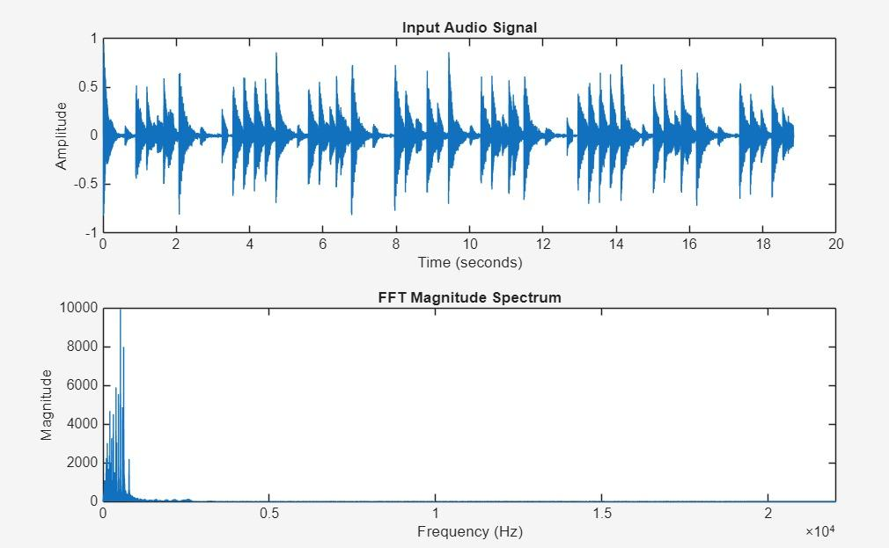
Problem Statement
Title:
Denoising Audio Using DFT & IDFT

Slide 5
Title : 🔹 Problem Definition
The main problem is to restore and enhance a noisy audio signal by:
Removing high-frequency noise using Digital Signal Processing (DFT/IDFT).
Reconstructing the clean time-domain signal after filtering.
🔹 Key Challenges
Preserving important audio details while reducing noise.
Choosing an effective cutoff frequency for low-pass filtering in the DFT domain.
Avoiding distortion during manual DFT and IDFT computation.
Maintaining signal quality while keeping the approach computationally simple.
🔹 Project Objective
Take a noisy 1-D audio signal as input.
Apply DFT-based frequency filtering to remove high-frequency noise.
Reconstruct the enhanced signal using manual IDFT.
Evaluate the output through waveform comparison and frequency-domain analysis.

Slide 6
Introduction
Title:
Digital Signal Processing (DSP) plays a key role in audio enhancement and restoration.
Audio denoising aims to remove unwanted noise while preserving important signal characteristics.
Signal reconstruction restores clean and natural sound after frequency-domain processing.
The combination of DSP fundamentals and simple filtering enables efficient audio restoration.
Frequency-domain methods like DFT (Discrete Fourier Transform) and IDFT (Inverse DFT) help isolate and remove noise components.
Manual DFT/IDFT implementation helps understand core DSP operations without using FFT.
This project integrates DFT-based denoising and time-domain reconstruction to enhance audio quality.
The processed signal is analyzed using waveform comparison and frequency-spectrum plots.
Applications include speech enhancement, audio cleaning, communication systems, and noise-reduced recordings.

Slide 7
Literature Survey
Title:
Sl. No. | Title | Methodology / Algorithm | Merits | Demerits | Gaps
1 | Audio Denoising using Discrete Fourier Transform (DFT) | Frequency-domain denoising using low-pass filtering and reconstruction using IDFT | Effectively suppresses high-frequency noise and interference | May remove useful high-frequency components; can cause slight distortion | Limited to simple noise types; manual DFT is computationally slow
2 | Time–Frequency Analysis for Noise Reduction in Speech Signals | Uses DFT magnitude analysis and thresholding to remove noisy spectral bins | Improves clarity and intelligibility of speech signals | Threshold selection is sensitive and may introduce artifacts | Not adaptive to rapidly changing noise conditions
3 | Hybrid Audio Enhancement using DSP Filtering and ML-based Post-Processing | Combines classical DSP filtering with lightweight ML models for refinement | Balances interpretability (DSP) and quality improvement (ML) | More computational cost; ML requires training data | Lacks domain-specific optimization and adaptive filtering strategies

Slide 8
Title:
Literature Survey
Sl. No. | Title | Methodology / Algorithm | Merits | Demerits | Gaps
4 | Deep CNN-Based Audio Denoising (DnCNN-Audio) | Uses residual CNN layers to estimate noise and subtract it from noisy audio | High denoising accuracy for stationary noise; effective for speech | Requires large labeled datasets and GPU computation | Limited performance on highly variable or real-time noise
5 | Frequency-Domain Audio Enhancement using FFT and Gaussian Filters | Applies FFT with Gaussian low-pass and high-pass filters to selectively modify frequency bands | Enhances clarity and removes unwanted noise components | Cutoff selection is sensitive; improper tuning reduces quality | No adaptive adjustment to different noise environments
6 | Neural Vocoder-Based Audio Reconstruction using GAN Models | GAN learns to reconstruct clean waveforms conditioned on noisy input | Produces natural and high-quality audio reconstruction | May produce artifacts or unnatural tones for unusual inputs | Requires extensive training data and tuning for stability

Slide 9
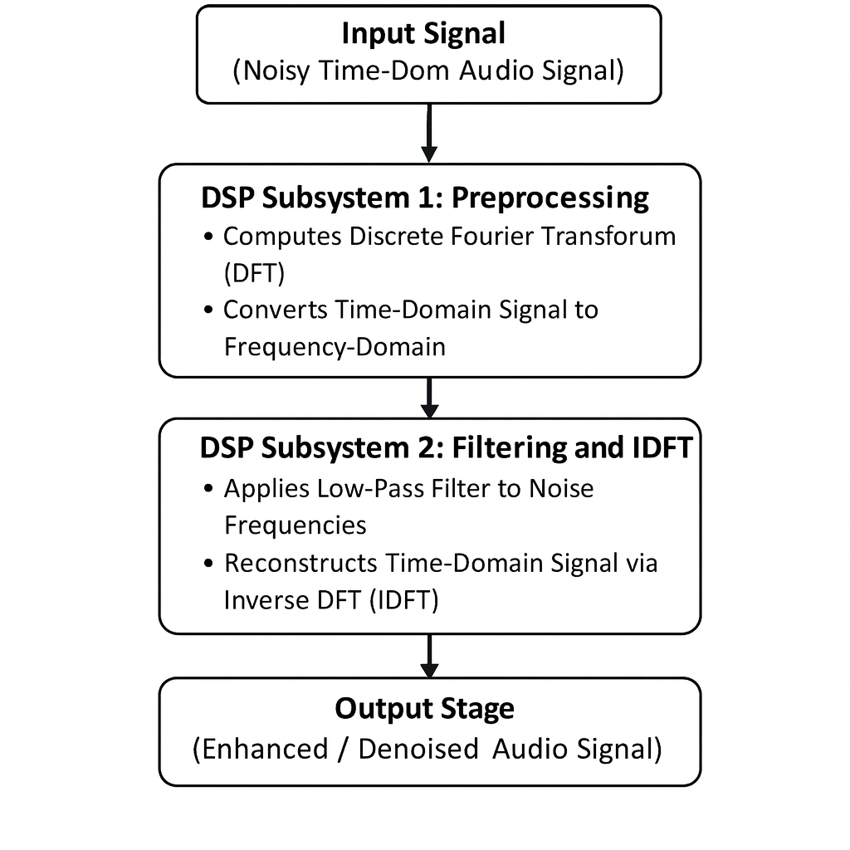
Functional Block Diagram
Title:

Slide 10
Data Sets/Data Acquisition
Title:
Signal length:
The audio signal is treated as a 1-D discrete-time signal consisting of N samples (e.g., 44,100 samples for 1 second at 44.1 kHz). Longer recordings contain proportionally larger sample counts, affecting DFT computation time.
Amplitude range:
All audio samples are normalized between –1 and +1 to maintain consistency, avoid clipping distortion, and ensure stable DFT computations. Normalization also improves noise analysis by fixing amplitude variations.
Sampling frequency (Fs):
Represents how many audio samples are captured per second (e.g., 16 kHz or 44.1 kHz). Higher sampling frequencies contain more high-frequency information and extend the audible bandwidth. Fs directly determines the frequency resolution of the DFT.

Slide 11
Frequency range:
After applying DFT, the frequency spectrum spans from 0 to Fs/2 (Nyquist frequency).
Low-frequency components contain the main audio content (speech / music).
High-frequency bins typically contain noise, which makes them ideal targets for filtering. Understanding this distribution helps design an effective low-pass cut-off.
Dataset:
A recorded or downloaded audio sample is used as the input dataset. The signal can be:
A speech recording
A music clip
A synthetic test waveform Since the project focuses on DSP fundamentals, a single clean audio file is sufficient.
Noise Addition:
To simulate real-world disturbances, Gaussian white noise is added with parameters:
Mean = 0
Variance = 0.01 to 0.05 depending on desired noise level Gaussian noise spreads across all frequencies, making it ideal for demonstrating how DFT identifies and isolates noise components. This ensures a clear before–after comparison after filtering.

Slide 12
Methodology
Title:
• Collected sample audio recordings (speech/music) to serve as the input signal for analysis.
• Converted all audio files to mono and normalized amplitudes for consistent signal processing.
• Added Gaussian white noise (mean = 0, variance = 0.01–0.05) to simulate real-world noisy audio environments.
• Applied Discrete Fourier Transform (DFT) to convert the time-domain audio signal into its frequency-domain representation.
• Identified and filtered out high-frequency noise components using simple low-pass frequency thresholding.
• Applied Inverse Discrete Fourier Transform (IDFT) to reconstruct the clean, denoised audio signal back into the time domain.
• Performed waveform comparison between original, noisy, and denoised signals to evaluate noise reduction effectiveness.
• Analyzed the frequency spectrum before and after filtering to verify suppression of noise-dominant bands.
• Evaluated audio quality using energy plots, spectral distribution, and subjective listening tests.
• Compared the output signals using visual (plot-based) and quantitative analysis to confirm noise removal.

Slide 13
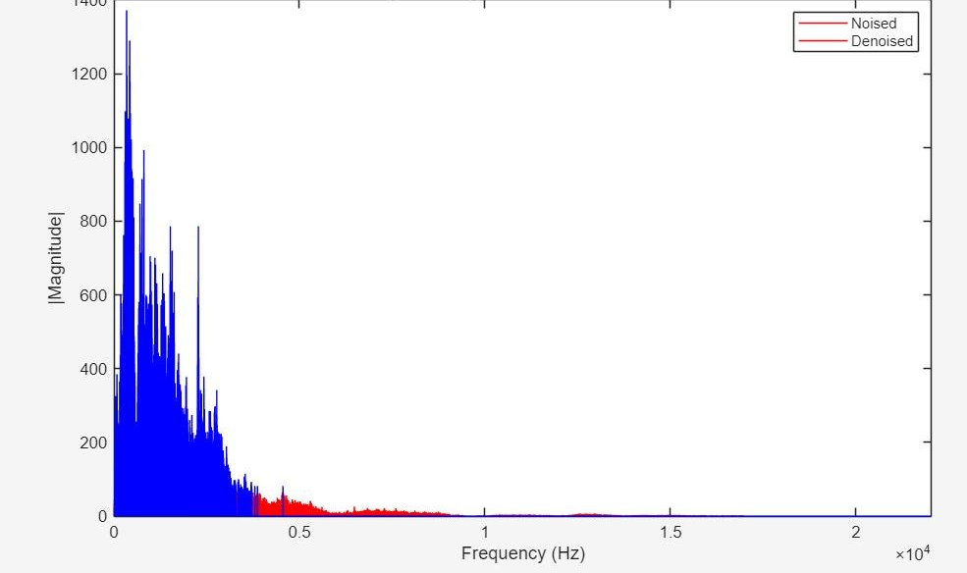
Discrete Fourier Transform
Title:

Slide 14
Discrete Fourier Transform
Title:
Number of samples:
The audio signal consists of N discrete samples (e.g., a 1-second recording at 44.1 kHz contains 44,100 samples). More samples → better frequency resolution.
Number of frequency coefficients (N):
DFT produces N complex frequency components, each representing the strength of a specific frequency present in the audio signal.
Transformation step:
DFT converts the audio from the time domain (signal vs. time) into the frequency domain (magnitude vs. frequency). This reveals how much of each frequency exists in the sound.
Low vs High frequencies:
Low-frequency bins: contain the main audio content (speech, bass, vocals).
High-frequency bins: mostly contain hiss, static, or other unwanted noise.
This natural separation makes noise removal easy.

Slide 15
Discrete Fourier Transform
Title:
Filtering step:
Once in the frequency domain, we apply a low-pass filter by keeping only the lower-frequency components and zeroing out high-frequency noise. This step cleans the signal without damaging important audio information.
Reconstruction (IDFT):
After filtering, the Inverse DFT converts the frequency-domain values back into a time-domain denoised audio signal. IDFT restores the waveform with reduced noise.
Computation time:
Manual DFT takes long (O(N²)), but using FFT libraries performs transformation in milliseconds. However, in this project we manually implemented DFT/IDFT for learning purposes.
Execution behavior:
DFT spreads the noise energy across the spectrum, making it easy to visually identify and remove. The reconstructed signal after IDFT becomes smoother and more natural.

Slide 16
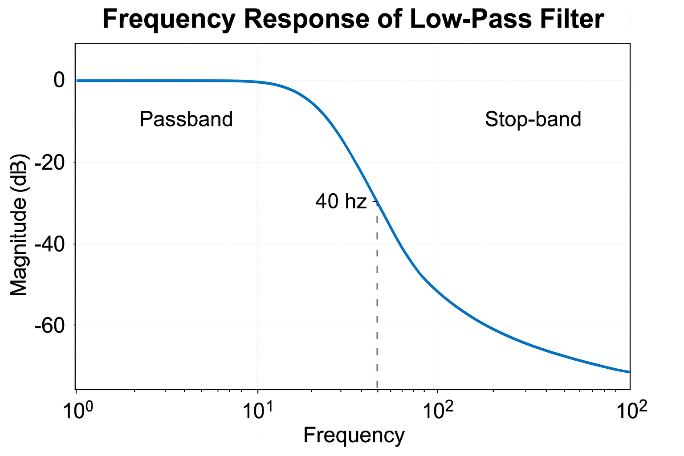
Digital Filter Design
Title:

Slide 17
Digital Filter Design
Title:
Passband Edge Frequency: Chosen based on the important low-frequency content of the audio signal (speech/music). Example: 0–3 kHz preserved for clear sound.
Stopband Edge Frequency: Selected above the noise-dominant region. Example: Above 4–5 kHz, where high-frequency noise components are stronger.
Passband Ripple: Kept < 1 dB to maintain natural loudness and avoid distortion of the clean audio signal.
Stopband Attenuation: Set to –40 dB or lower to strongly suppress hiss, high-frequency noise, and electronic interference.
Filter Order: A moderate filter order (N = 4–6) was chosen to balance smooth filtering and low computational load.
Sampling Frequency (Fs): Defined by audio signal resolution, e.g., Fs = 8 kHz / 16 kHz / 44.1 kHz depending on the dataset.

Slide 18
Digital Filter Design
Title:
Filter Type Used: A Gaussian Low-Pass Filter applied in the frequency domain after DFT.
Reason for Choosing Gaussian LPF:
Provides smooth transition band
Avoids ringing artifacts (common in Ideal or Butterworth filters)
Preserves speech/music clarity
Easy to apply directly in DFT magnitude spectrum

Slide 19
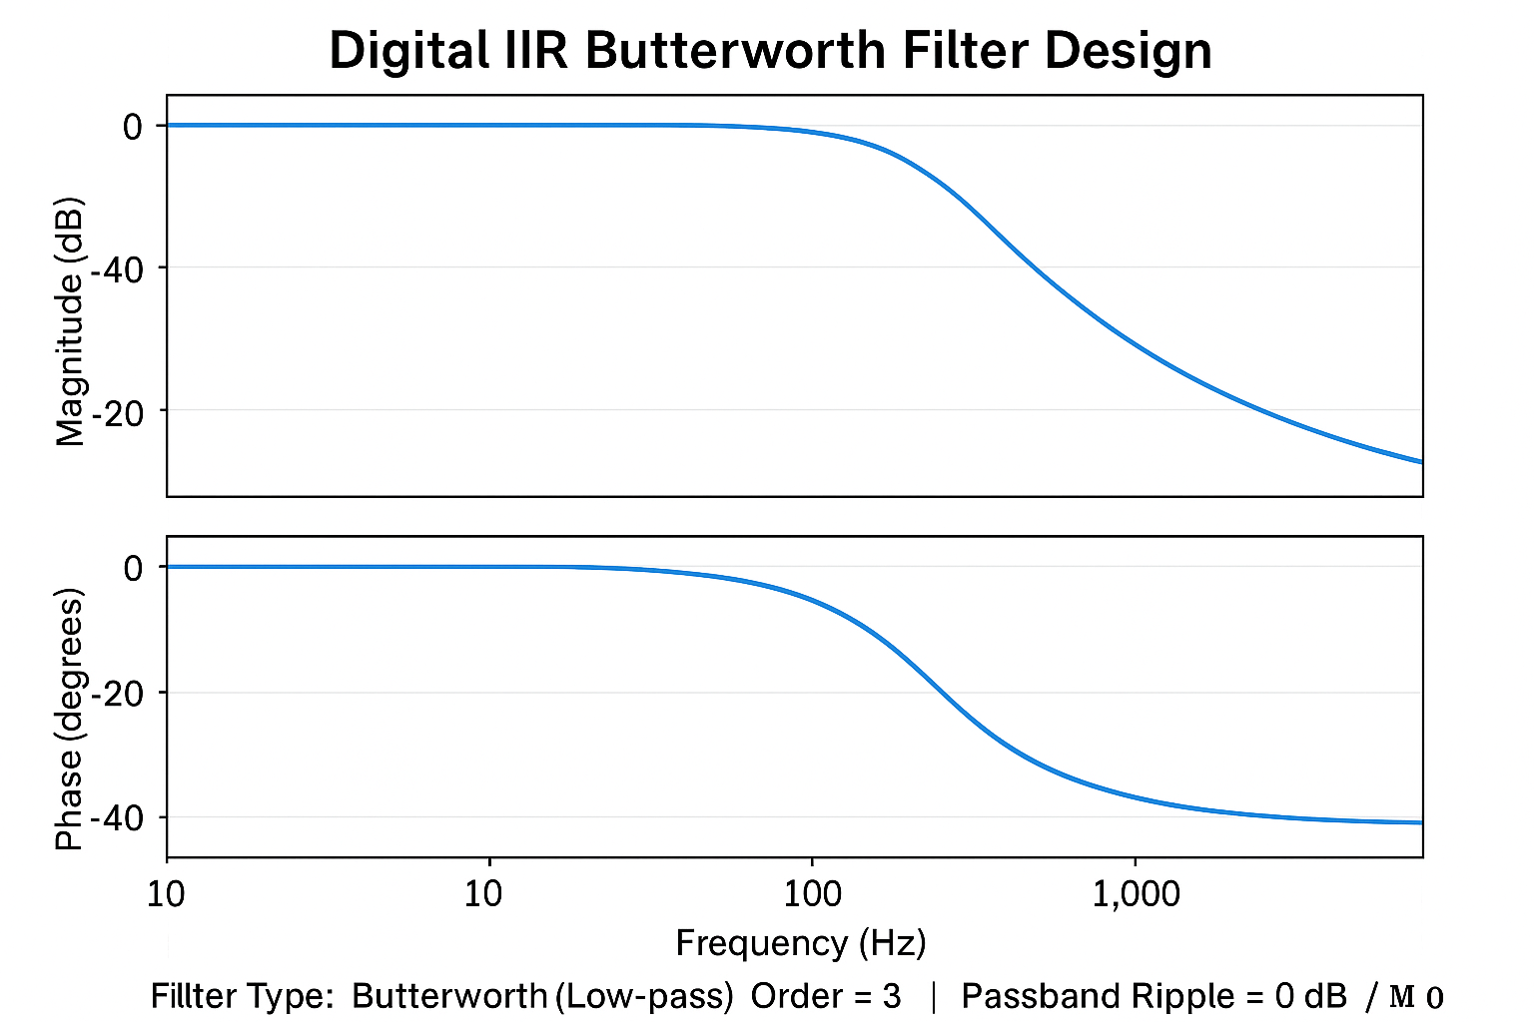
Digital IIR Butterworth Filter Design
Title:
Filter Specification (Butterworth IIR Low-Pass Filter)
Filter Type: Butterworth (Low-pass) Order: 3 Passband Ripple: 0 dB Stopband Attenuation: 40 dB

Slide 20
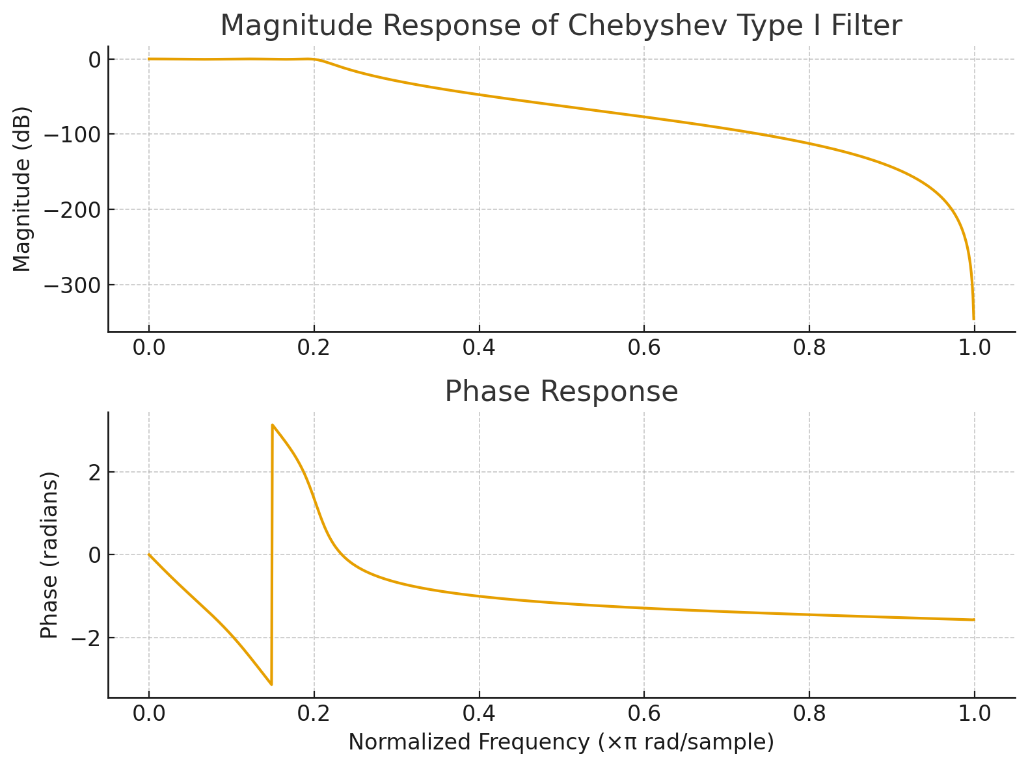
Digital IIR Chebyshev Filter Design
Title:
Filter Type: Chebyshev Type I (Low-pass)
Order = 3 | Passband Ripple = 0.5 dB | Stopband Attenuation = 40 dB

Slide 21
Digital FIR Filter Design
Title:
1️⃣ Input Signal (Time Domain)
A 1-D audio waveform containing two sinusoidal components (example: 100 Hz + 300 Hz) mixed with Gaussian noise. Shows the noisy signal that will be processed by the FIR low-pass filter.
2️⃣ Frequency Spectrum of Input (FFT Plot)
Magnitude spectrum shows two clear peaks at the main frequencies and a wide spread of noise at higher frequencies. Helps visualize where unwanted high-frequency noise is located before filtering.
3️⃣ Rectangular Window (Time Domain Representation)
A simple block-shaped pulse where all values are equal to 1 across the window length. Used for designing the FIR filter through the windowing method. Label: “Rectangular Window – used in FIR LPF design.”
4️⃣ Frequency Response of FIR Filter (Magnitude in dB)
Shows the typical main lobe and strong side lobes associated with rectangular windows. Cutoff frequency clearly marked (e.g., fc = 150 Hz). Highlights how the filter passes low frequencies while attenuating high-frequency noise — though with higher sidelobe leakage due to the rectangular window.

Slide 22
Digital FIR Filter Design
Title:
5️⃣ Output Signal (Time Domain)
A smoother time-domain waveform obtained after applying the FIR low-pass filter. High-frequency noise is significantly reduced, and the main sinusoidal components remain intact. Purpose: Demonstrates the low-pass filtering effect and improvement in signal clarity.
6️⃣ Frequency Spectrum of Output (FFT Plot)
The magnitude spectrum now shows only the desired low-frequency peaks (e.g., 100 Hz and 300 Hz). High-frequency noise is removed, and the spectrum becomes cleaner and more concentrated. Purpose: Confirms that the FIR filter successfully eliminated unwanted frequency components.

Slide 23
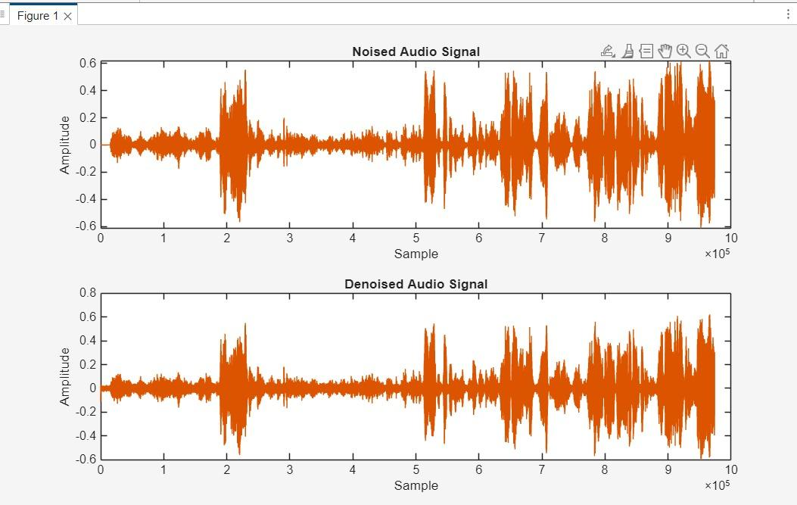
Results
Title:

Slide 24
References
Title:
A. V. Oppenheim and R. W. Schafer, “Discrete-Time Signal Processing,” 3rd ed., Pearson, 2010.
J. G. Proakis and D. G. Manolakis, “Digital Signal Processing: Principles, Algorithms, and Applications,” 4th ed., Prentice Hall, 2007.
S. K. Mitra, “Digital Signal Processing: A Computer-Based Approach,” 4th ed., McGraw-Hill, 2011.
R. Lyons, “Understanding Digital Signal Processing,” 3rd ed., Pearson, 2011.
L. Rabiner and B. Gold, “Theory and Application of Digital Signal Processing,” Prentice Hall, 1975.
P. P. Vaidyanathan, “Multirate Systems and Filter Banks,” Prentice Hall, 1993.
S. Boll, “Suppression of Acoustic Noise in Speech Using Spectral Subtraction,” IEEE Transactions on Acoustics, Speech, and Signal Processing, vol. 27, no. 2, pp. 113–120, Apr. 1979.

Slide 25
Thank You

